Slide 1
Google Analytics Customer Revenue Prediction
EDA

Slide 2
competition
https://www.kaggle.com/c/ga-customer-revenue-prediction

Slide 3
contents
Data contour
NA inspection
Exploring the data transaction revenue, week, hour, login times, city, network domain, time on site, channel grouping, operation system
Summary alluvial plot, world plot
The importance of variable

Slide 4
Data contour
NA inspection
Exploring the data transaction revenue, week, hour, login times, city, network domain, time on site, channel grouping, operation system
Summary alluvial plot, world plot
The importance of variable

Slide 5
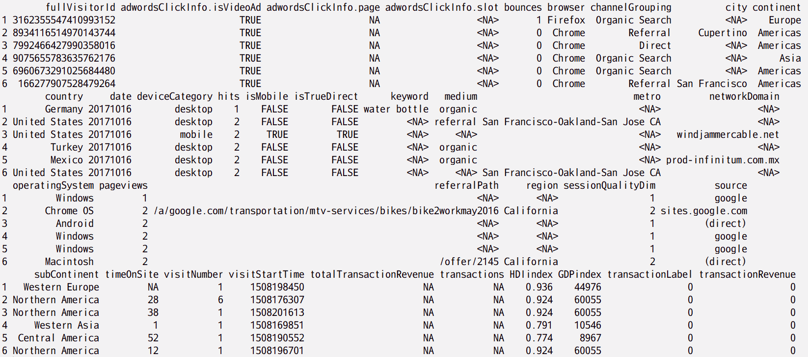
DATA contour

Slide 6
Data contour
NA inspection
Exploring the data transaction revenue, week, hour, login times, city, network domain, time on site, channel grouping, operation system
Summary alluvial plot, world plot
The importance of variable

Slide 7
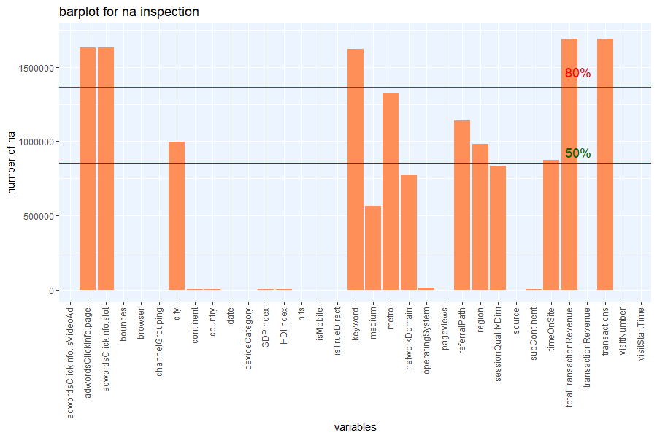
NA inspection
This data contain 1708337 samples with 34 independent variables and 1 dependent variable(transactionRevenue). (HDI and GDP added as external data. )
It seems that there are lots of NA values (missing data) in this data set.

Slide 8
Data contour
NA inspection
Exploring the data transaction revenue, week, hour, login times, city, network domain, time on site, channel grouping, operation system
Summary alluvial plot, world plot
The importance of variable

Slide 9
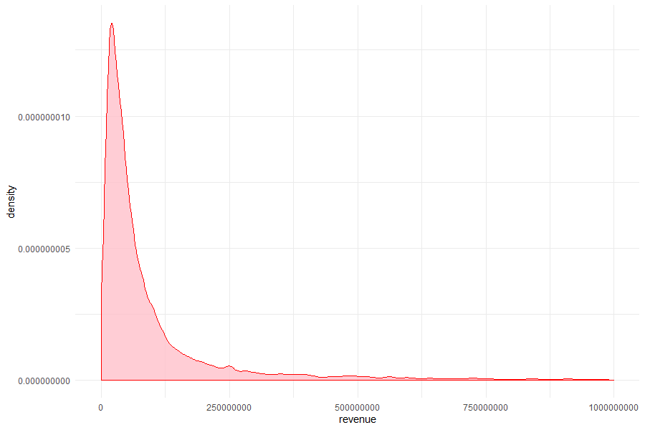
Transaction revenue
The distribution of non-zero transaction revenue is an extremely right-skewed distribution.
We can expect that there are vast amounts of outliers.

Slide 10
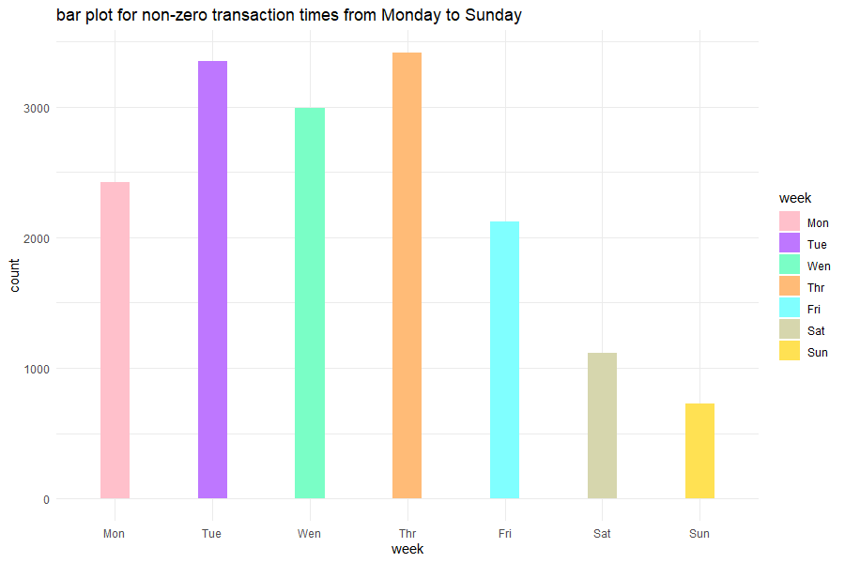
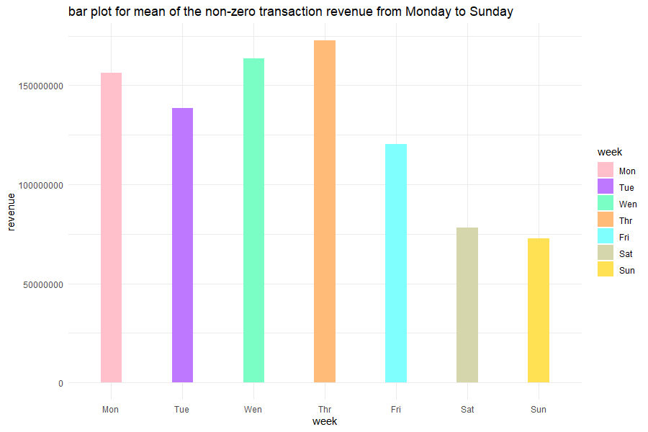
week
This variable is extract from the visitStartTime in the original data.
I’d like to check if this variable may be useful while building a model.
On the first plot(on the top left side), it seems the transaction times is varied from Monday to Sunday and concentrate between Tuesday and Thursday.
In addition, I check the mean of the transaction revenue each day. It seems also varied with the day, and Monday to Thursday possess higher value.
Also, I applied the Anova test to check if the total non-zero transaction revenue is genuinely different from Monday to Sunday.
The p-value is 0, which means the Null hypothesis that the mean of revenue from Monday to Sunday are the same will be rejected under the significant level 0.05.
Source of variability | P-value
week | 0

Slide 11
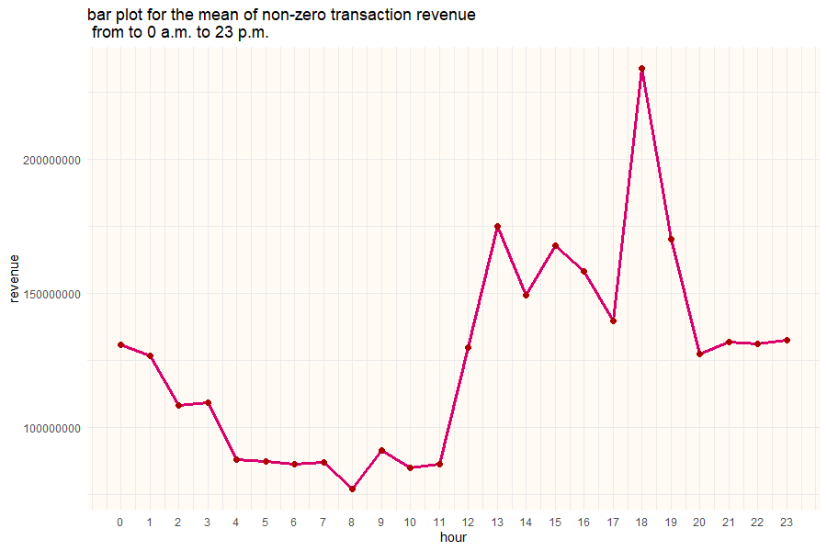
hour
It is obvious that the mean of revenue among 24 hours in one day are varying with an hour and are quiet distinct. Hour may also a good predictor. The revenue value is roughly gradual improvement from 11 o’clock to 18 o’clock and reaches the peak at 18 o’clock which may people usually do transaction after hours.
Anova test is considered as statistical supporting.
The Anova test shows there is a strong evidence support for rejecting the null hypothesis, which is the mean of revenue by each hour are the same.
Source of variability | P-value
week | 0

Slide 12
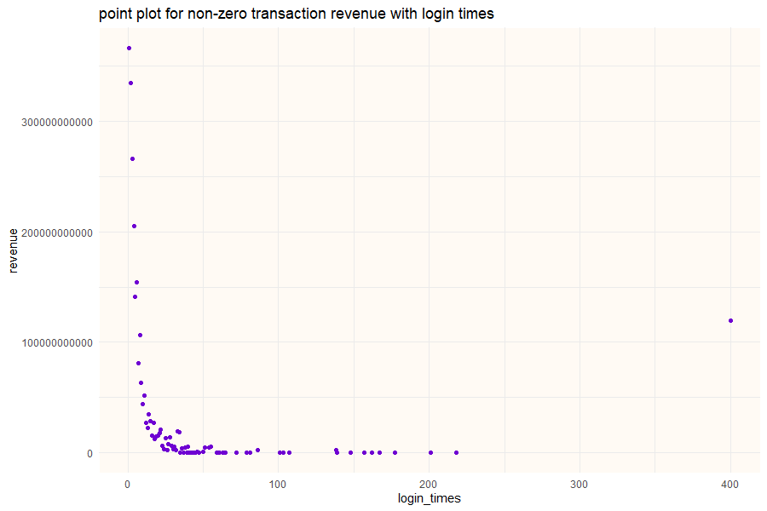
Login times
Usually, fewer login times generate more revenue.

Slide 13
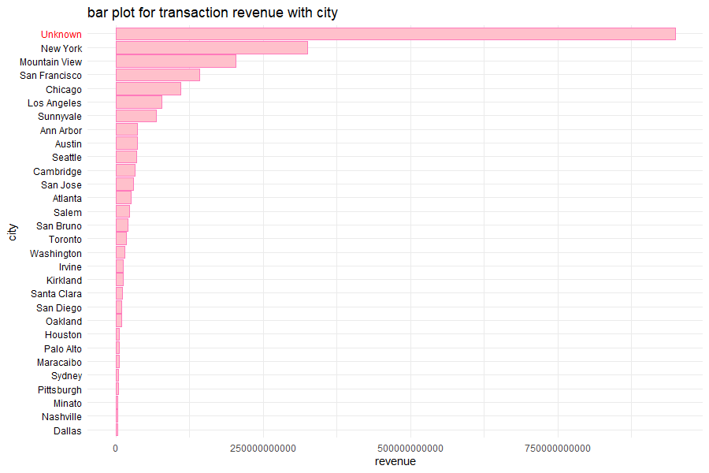
city
Thirty cities are showing on the plot.
It is obviously that this variable contain lots of NA values.
Does it make sense if I fill the NA value with mode? Let’s get more detail on the next page.

Slide 14
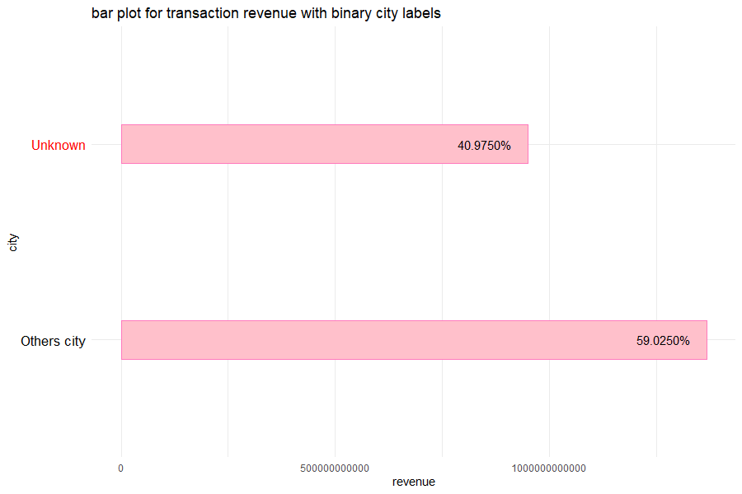
Up to 40%, the sum of transaction revenue is coming from unknown(NA value) in the “city” variable.
It seems to me that it doesn’t make sense if I fill the NA value with mode.
Keeping NA.

Slide 15
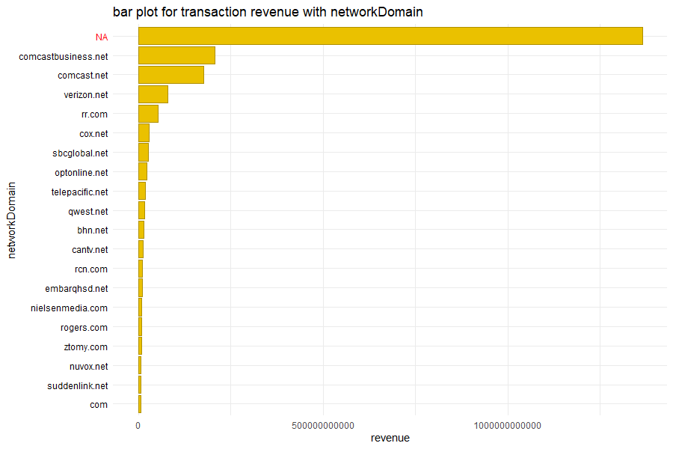
Network domain
Let’s look at the revenue by network domain.
Numbers of transactions occur with the label of NA.

Slide 16
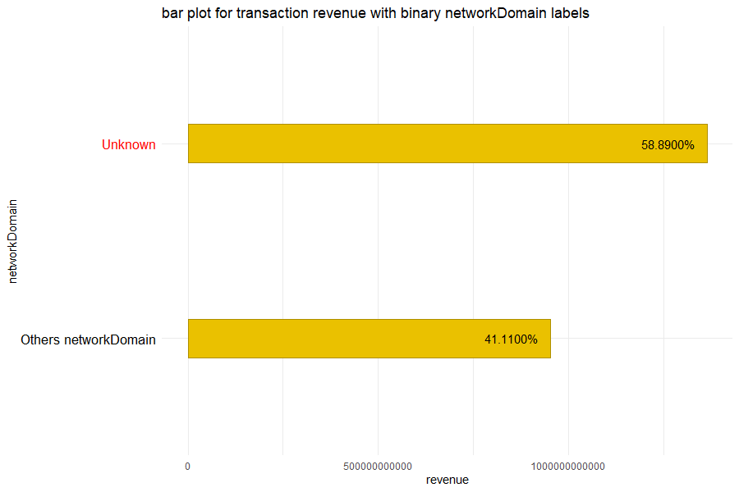
Nearly 60% the sum of transaction revenue is coming rom unknown(NA value) in network domain variable.
Keeping NA.

Slide 17
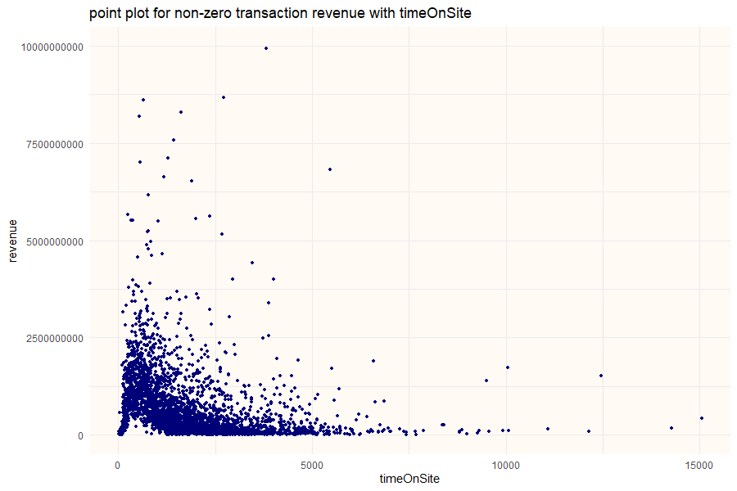
Time on site
Over 50 % of data are labeled with NA. There is an interesting fact showing on the table. Only 0.02% revenue come with NA.
Another interesting thing is that fewer timeOnSite earn the store more revenue.
Remaining NA.
timeOnSite | NA | Not NA
revenue | 488850000 | 2315856130000
ratio | 0.0002 (0.02%) | 0.9998 (99.98%)

Slide 18
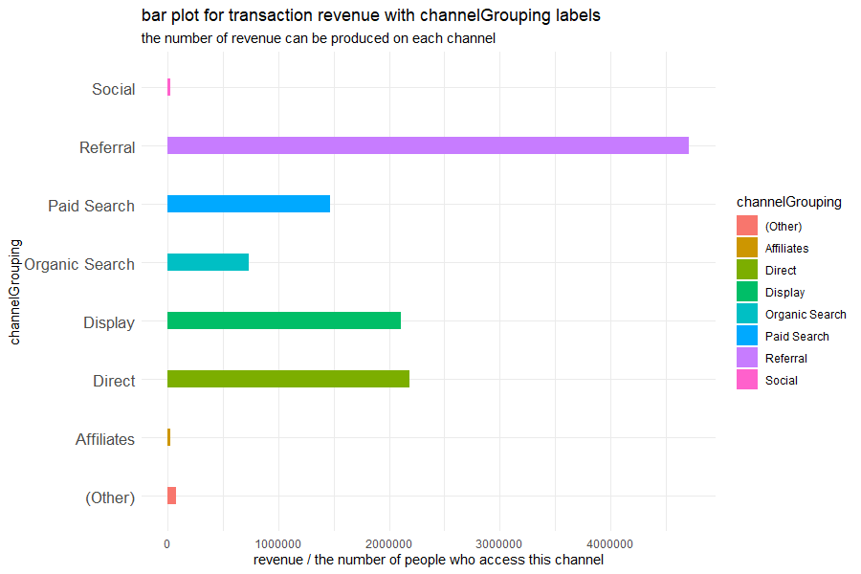
Channel grouping
People who access the Referral path have the highest possibility of making a transaction. The referral path earn the most revenue among these channel.
The second is Display and Direct.
The x-axis is defined as the total revenue on each channel divided by the number of people who access this channel

Slide 19
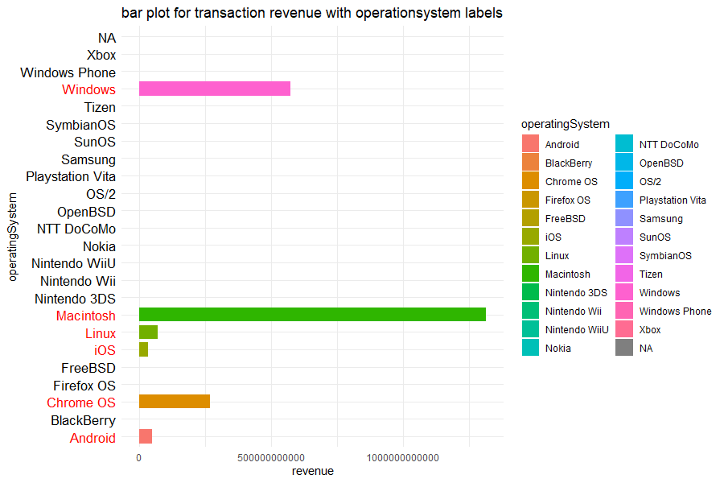
Operation system
Let’s look at the revenue by operation system.
There are 24 operation system(including label NA). The transaction only occurs when a user browser store with Windows, Macintosh, Linux, iOS, Chrome OS and Android. Therefore, the operation system might be a good predictor.

Slide 20
Data contour
NA inspection
Exploring the data transaction revenue, week, hour, login times, city, network domain, time on site, channel grouping, operation system
Summary alluvial plot, world plot
The importance of variable

Slide 21
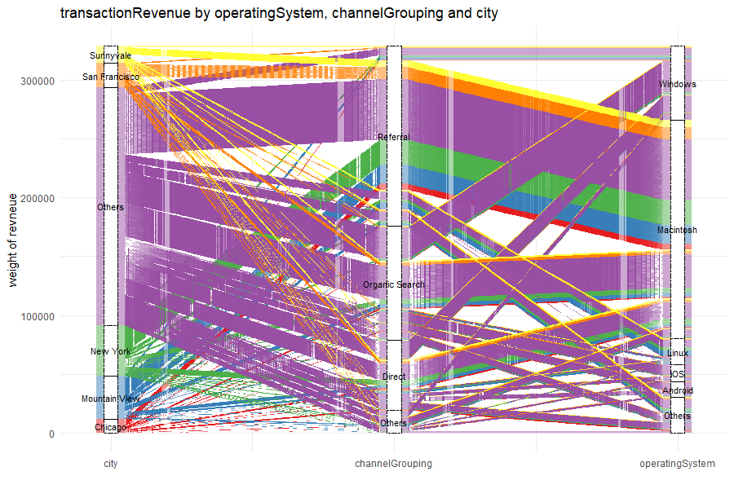
Summary - Alluvial plot (city, network domain, channel grouping, operation system, transaction revenue)
Let’s look at the multi-variable interactions.
The “Others” in city means all city in the data except for Sunnyvale, San Francisco, New York, Mountain View and Chicago, which are the top 5 cities with the most transaction times. The “Others” in ChannelGrouping and operationSystem are similar to the above.
People who access the store via Referral path have the tendency to use the Macintosh system.

Slide 22
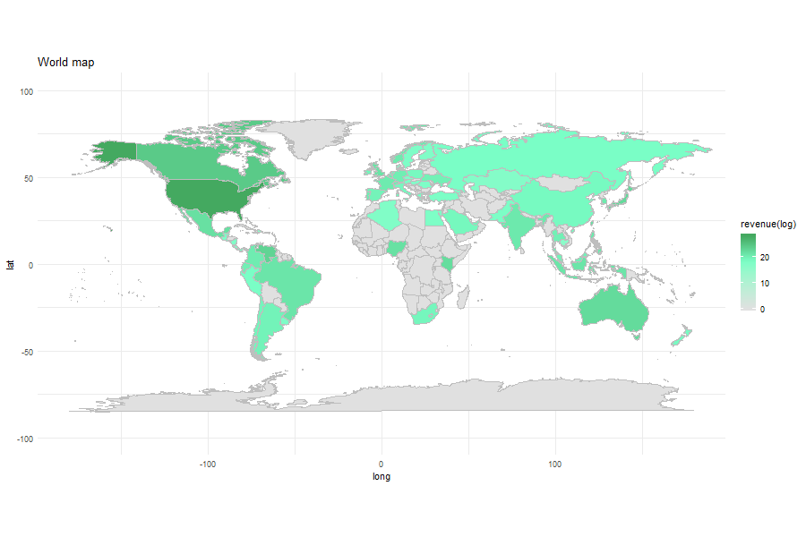
Summary – world map
World map(revenue) refer to
https://rpubs.com/effml68477/GACRPworldmap
More world map
https://beta.rstudioconnect.com/content/8119/
It may take some time to load the content.

Slide 23
Data contour
NA inspection
Exploring the data transaction revenue, week, hour, login times, city, network domain, time on site, channel grouping, operation system
Summary alluvial plot, world plot
The importance of variable

Slide 24
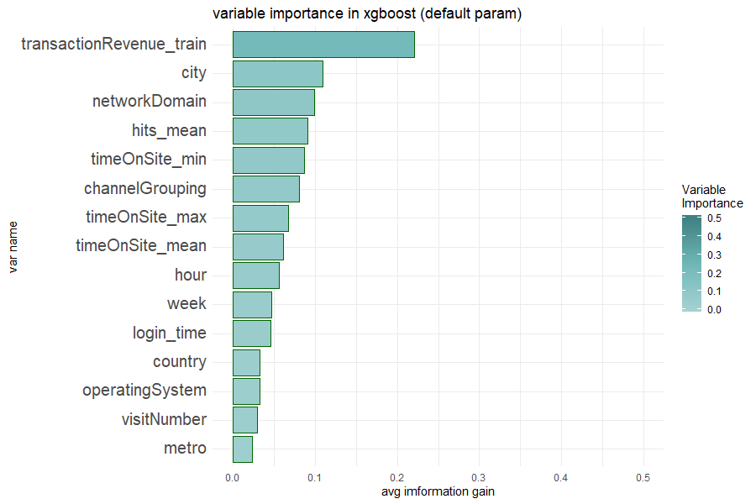
The correlation between numeric variable and transaction revenue
Since there are lots of NA values, I utilized the variable importance based on Xgboost as a correlation.
This plot shows the top 15 variables, which is possessing the most average information gain.
Hour, Week and Login Time extracted form the internal data.

